Slide 1

The World Through the Eyes of U.S. Media The New York Times
Tra Dinh
MM/DD/20XX

Slide 2
Research Question: Which countries dominated U.S. front-page attention from 1900–2025?

Slide 3
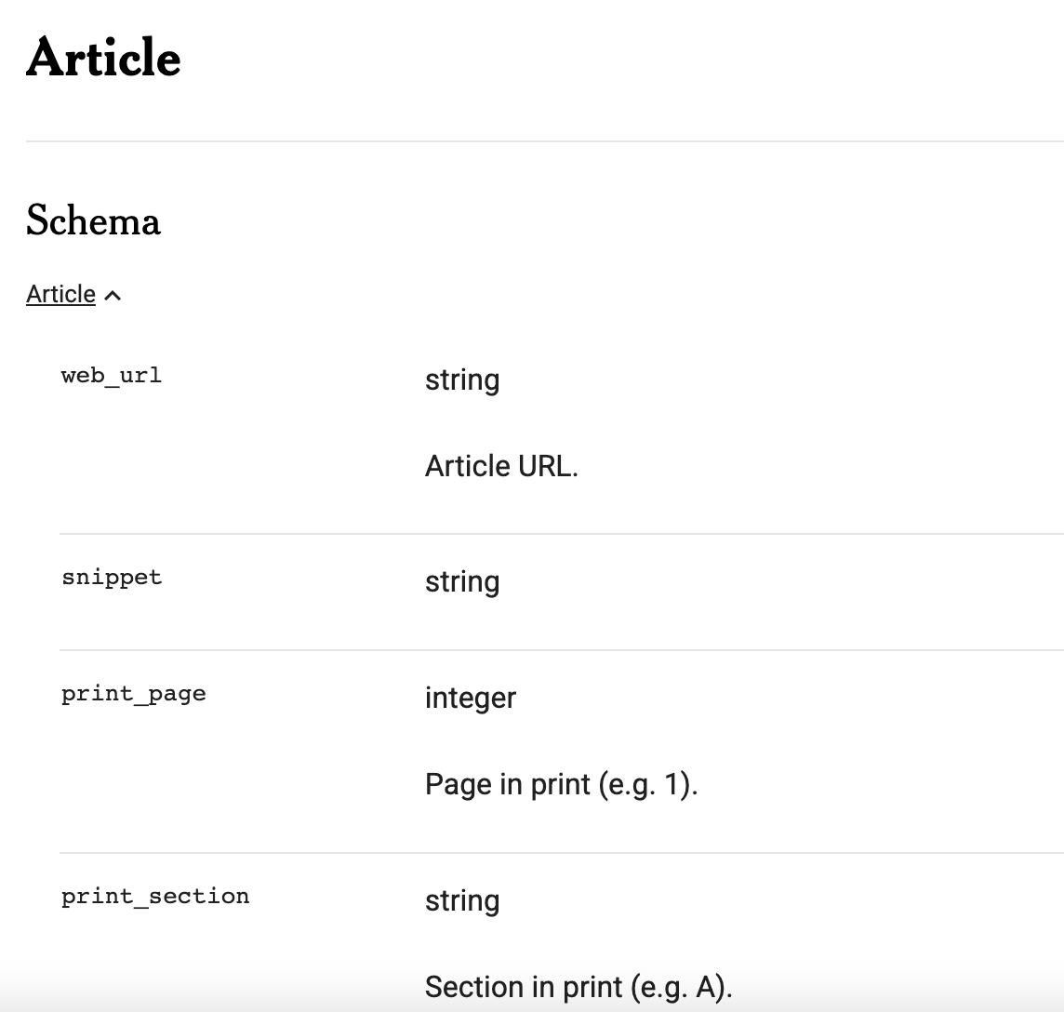
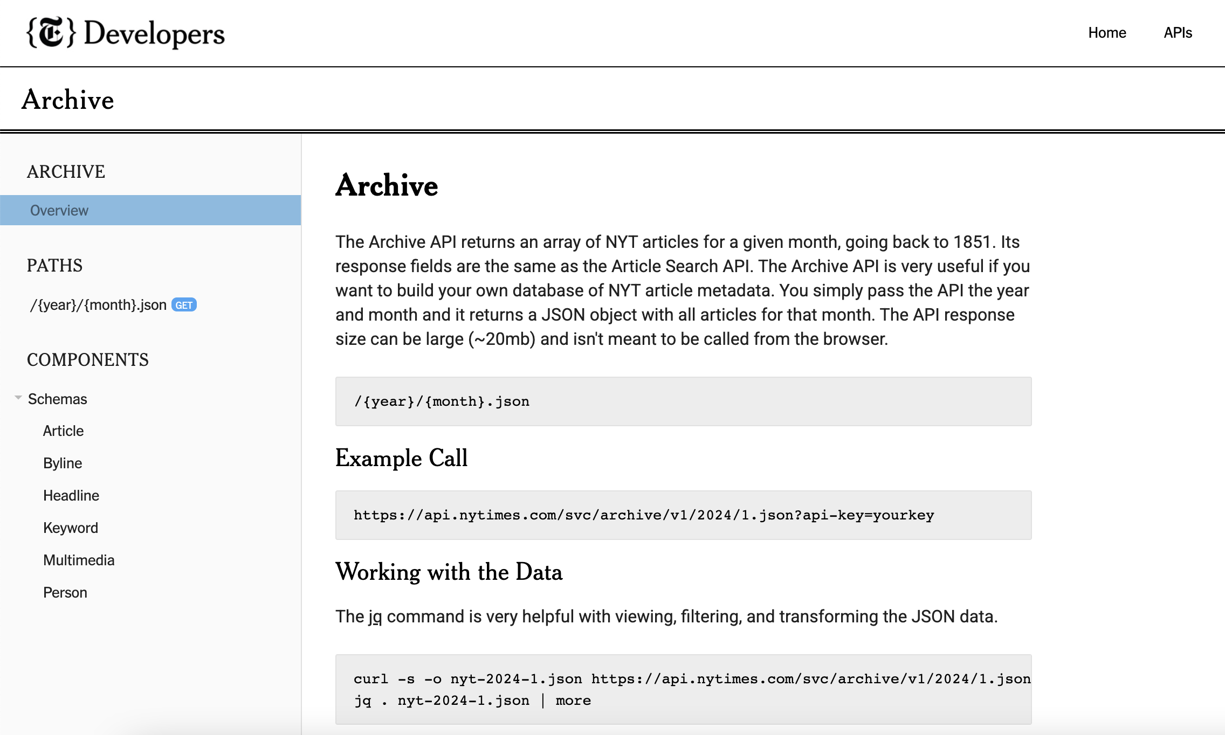
Tractable data
Data source: NYT Archive API https://developer.nytimes.com/get-started
Time span: 1900–2019
Unit of analysis: Front-page articles only. Front page reflects editorial priority and agenda-setting.
Variables:
headline
abstract
pub_date
section_name
extracted countries
sentiment score

Slide 4
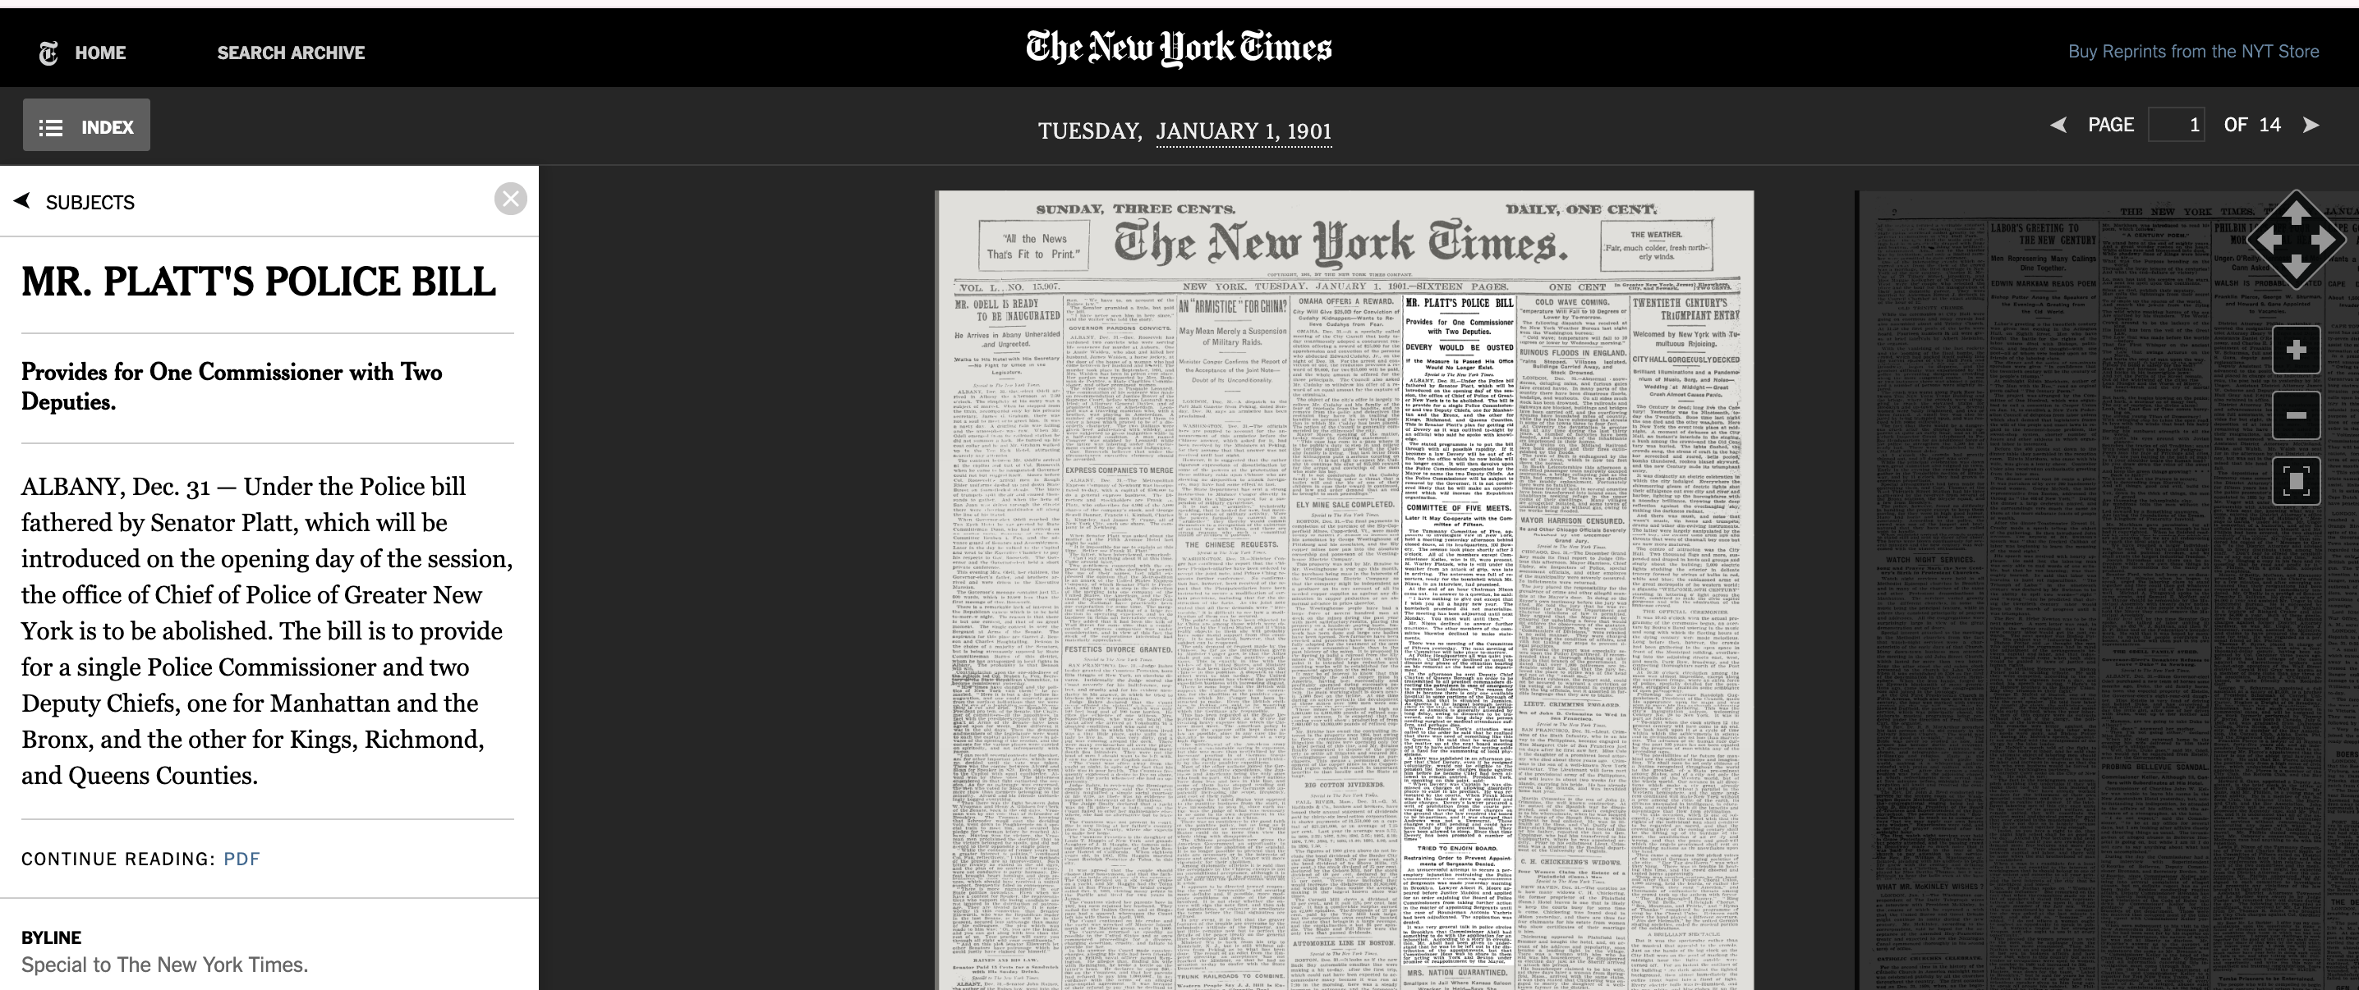

pub_date | headline | abstract | section_name | print_section | print_page | news_desk | type_of_material | web_url | _id
1901-01-01T05:00:00+0000 | MR. PLATT'S POLICE BILL; Provides for One Commissioner with Two Deputies. | Tammany Committee of Five May Co-operate with Committee of Fifteen | Archives |  | 1 | None | Archives | https://www.nytimes.com/1901/01/01/archives/mr-platts-police-bill-provides-for-one-commissioner-with-two.html | nyt://article/0dd79496-c2df-53b4-aa60-9940762b12bc
1901-01-01T05:00:00+0000 | AUTOMOBILE LINE IN BOSTON. |  | Archives |  | 1 | None | Archives | https://www.nytimes.com/1901/01/01/archives/automobile-line-in-boston.html | nyt://article/0deccd1c-7d5e-5be8-b252-417bec4a9cd1

Slide 5


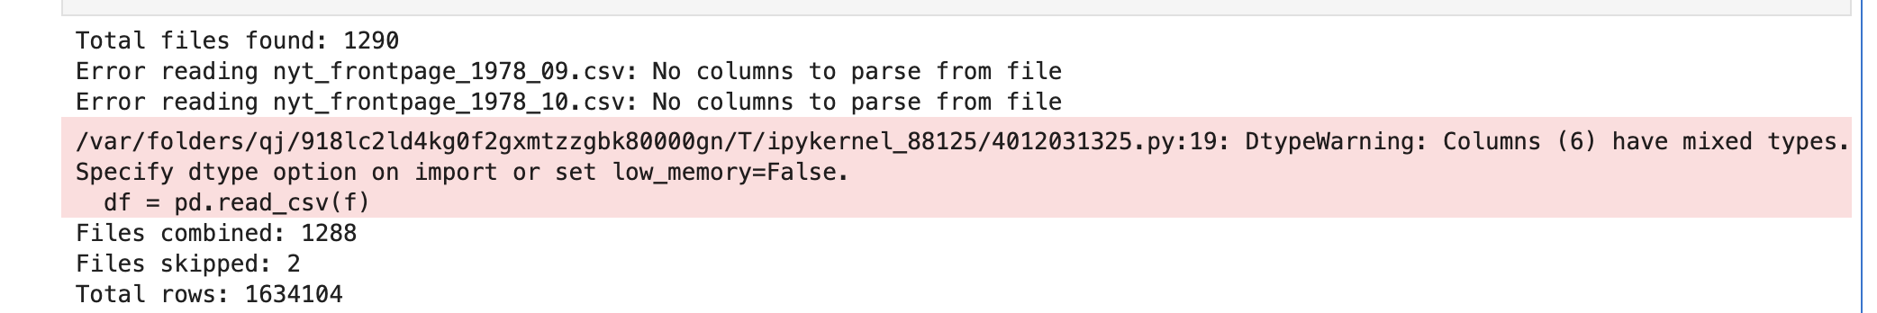

Data Retrieval
Used NYT Archive API
- Pulled data month-by-month
- Filtered:
- document_type == article
- print_page == 1
- Extracted country names using NLP (spaCy NER)
- Normalized country names + capital mapping

Slide 6
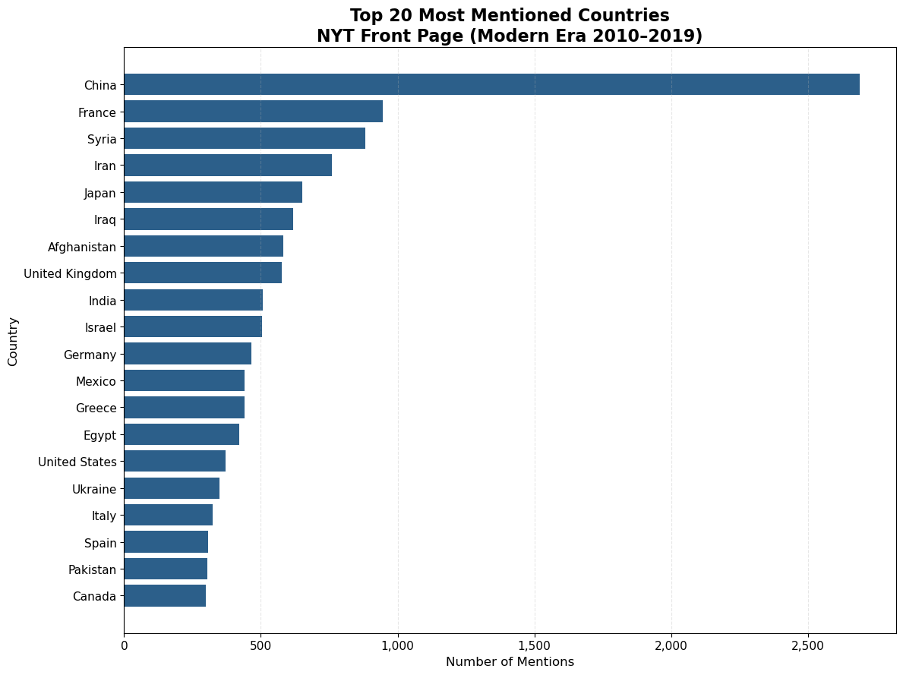
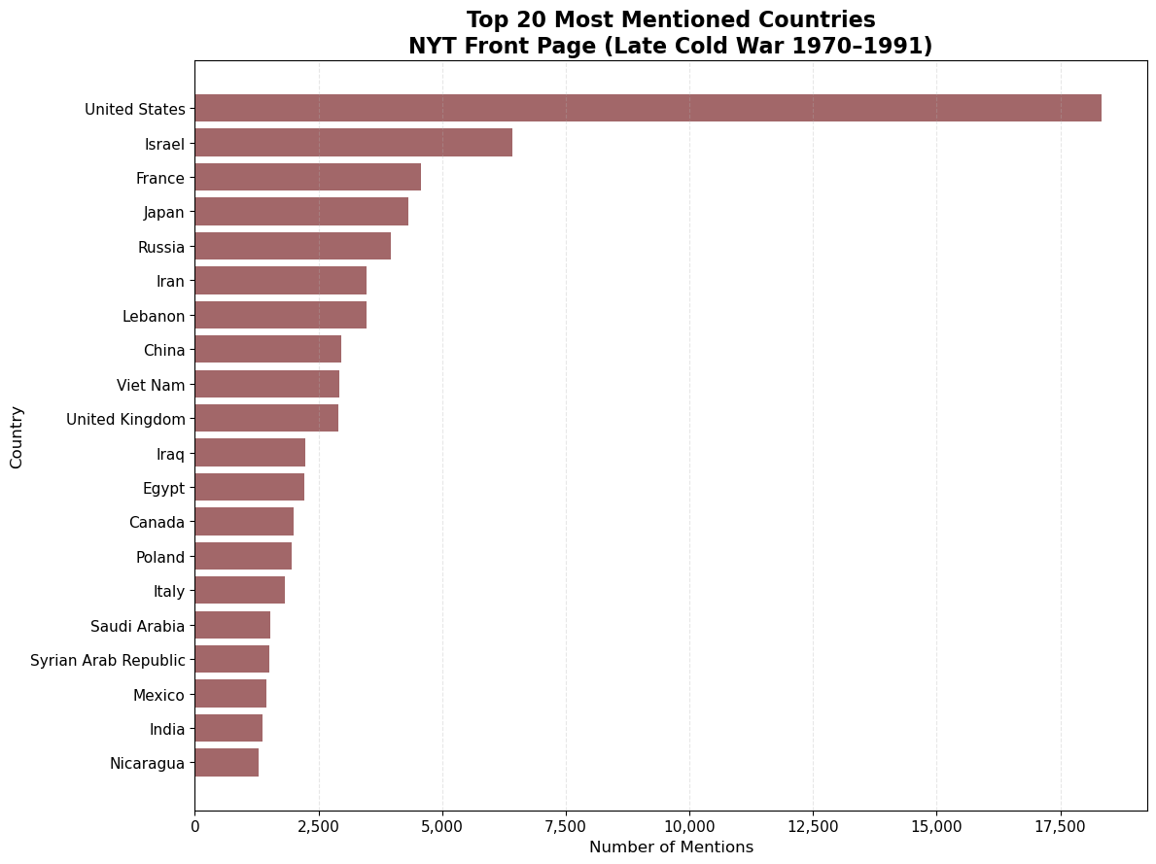
Exploratory Data Analysis (EDA): Compare Late Cold War vs Modern Era

Slide 7
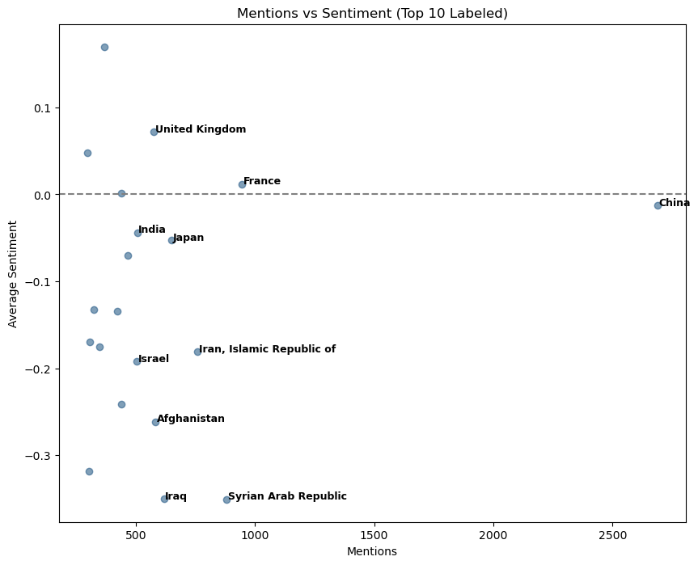
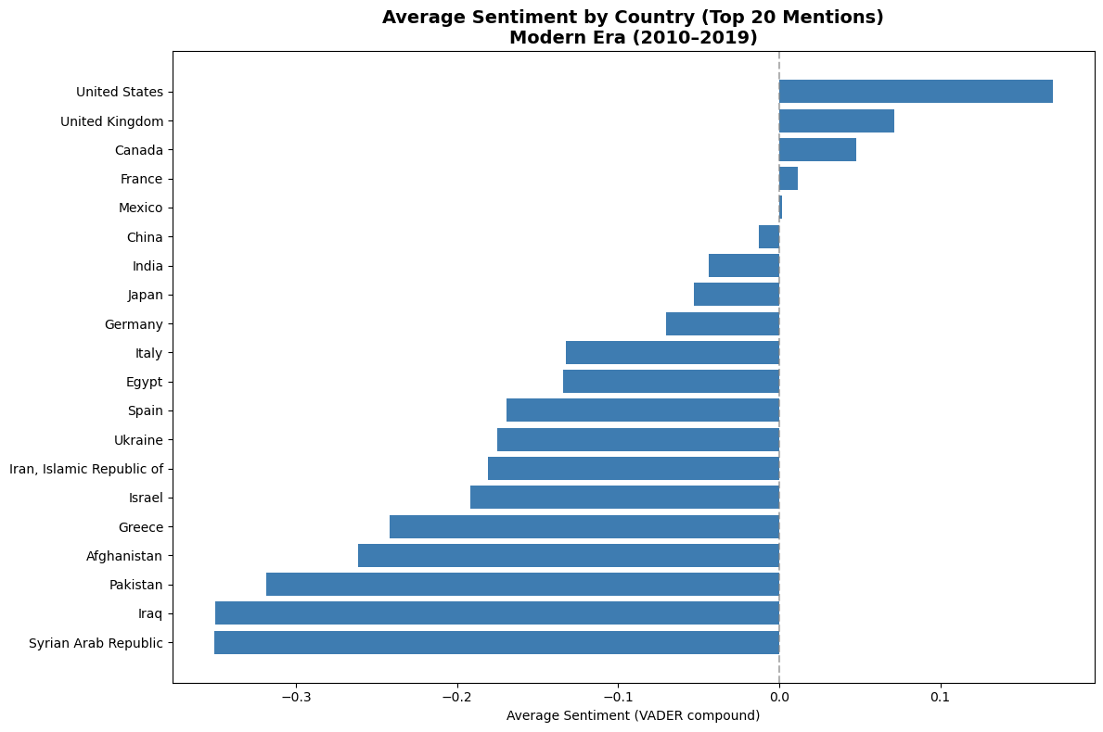

Slide 8
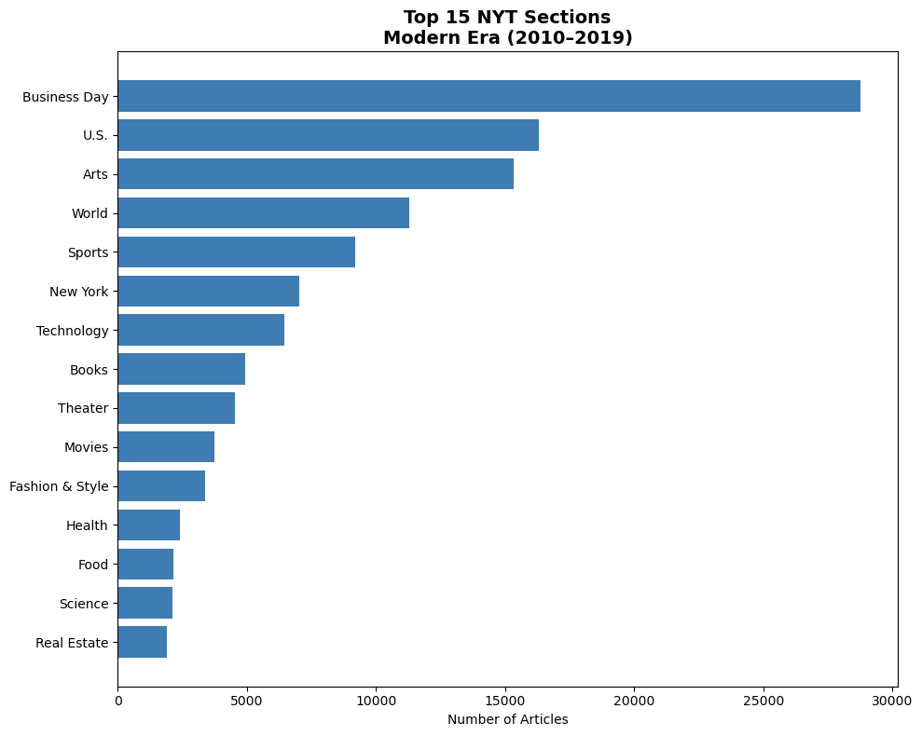

Slide 9
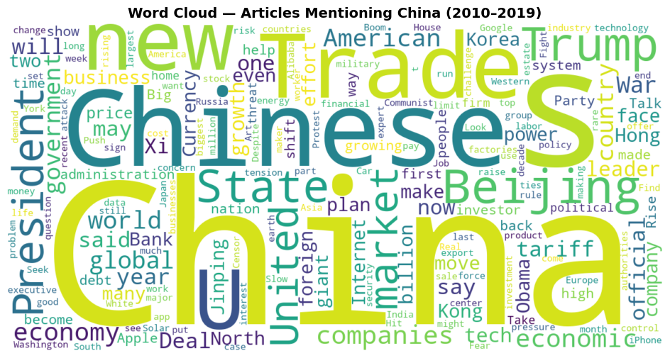

Slide 10
Implications for stakeholders
Media scholars and journalists
Gain insight into long-term patterns of media attention and editorial priorities
Better understand how news institutions shape public awareness of global events
Historians and political scientists
Use the findings to contextualize U.S. perspectives on international relations across different historical periods
Identify how wars, diplomacy, and power shifts influence media focus
Policy analysts and international relations researchers
Understand which countries have historically dominated U.S. media attention and how that visibility aligns with foreign policy priorities

Slide 11
Ethical, Legal, Societal Implications
To understand how U.S. media attention toward different countries has changed over time
To examine how major global events (wars, political conflicts, economic crises) influence which countries dominate U.S. news coverage
To analyze front-page headlines as a reflection of collective awareness and national priorities in the United States
To treat media coverage as a lens shaping public perception, rather than an objective measure of global importance

Slide 12
Engagement & Originality
120-year longitudinal media analysis
Era comparison framework
Sentiment + frequency relationship
Capital-to-country NLP mapping
Comparative Cold War vs Modern Era framing

Slide 13
Conclusion
Limitations & Key Insights
Limitations
Takes a lot of time to load the data.
Country detection relies on a predefined dictionary (201 country names + capitals), which may miss references using:
- President names (e.g., “Trump,” “Putin”)
- Major cities not included in the dictionary
- Historical country names (e.g., USSR)
Some years contain missing or incomplete data.
Sentiment analysis (VADER) captures surface tone and may not detect nuanced geopolitical framing.
Headline and abstract text may not fully represent the article’s complete narrative.
Key Findings
Media attention shifts reflect broader geopolitical power transitions.
Coverage is generally crisis-driven and skews negative.
During the Cold War, coverage was highly concentrated around bipolar superpowers.
In the Modern Era, attention is more multipolar but remains concentrated among major global powers

